Slide 1
UEIM007 FINANCIAL MANAGEMENT
GROUP ASSIGNMENT
TOPIC : DEPOSIT ACCOUNTS IN A BANK

Slide 2
What is a Deposit account?

Slide 3
Deposit Account
A deposit account is a bank account held by a financial institution where money can be deposited and withdrawn by a customer. Savings accounts, current accounts, or any of the other forms of accounts listed below may be deposit accounts.

Slide 4
Deposit Account
General
Customer
Banks
The account holder (customer) maintains the right to have the deposited money returned on appeal, subject to limitations imposed by the terms and conditions of the account.
In general, the verbs "deposit" and "withdrawal" in banking signify a customer paying money into an account and taking money out of it, respectively
Bank deposits consist of money held for safekeeping in banking institutions. Customer’s cash deposit, the legal title to the cash is surrendered, and it becomes the bank's asset. The account is, in essence, a liability to the bank.

Slide 5
Types of Deposit Accounts
Current Account
Savings Account
Recurring Deposit
Fixed Deposit

Slide 6
Current Account

Slide 7
What is Current Account ?
Also known as Financial Account.
Deposit Account maintained by who carry out higher number of transactions..
It’s related to liquid deposit and offers broad range of customized options.
Generally, It doesn’t provide interest and require higher minimum balance.

Slide 8
Types
Standard Current Account
Package Current Account
Single Column Cash book
Premium Current Account
Foreign Currency Account

Slide 9
Conditions
Current account require higher minimum balance compared to savings account.
Non maintenance of minimum balance can attract penalty charges.
For single business, there cannot be multiple current accounts.

Slide 10
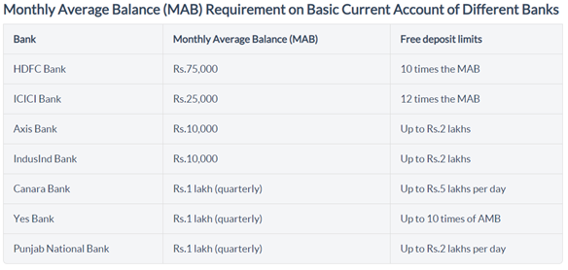

Slide 11
Features and Benefits

Slide 12
Features and Benefits
Easy Transactions
Interest
Other benefits
It is primary requisite for starting a business because it allows transactions beyond scope of savings account.
It provides frequent transactions with no restrictions on number of transactions in a day.
The prime objective is to facilitate smooth transactions for business.
Now a days, Some banks provide interest rates on current account as well.
Current account charge interests on short-term funds the account holder has borrowed from bank.
A current account can be operated by individuals, public and private companies,etc.
No limit in withdrawals.
Provide overdraft facility.
Provides internet banking and mobile banking facility.

Slide 13
Savings Account

Slide 14
What is Savings Account ?
Deposit account
Can open at any retail bank or financial institution
Deposit idle funds and use when required
Many type of savings account for women, minor, senior citizens, farmers etc..
NEFT / RTGS / IMPS for funds transfer

Slide 15
Conditions
Different banks have their own policies for minimum balance required.
It can be 500 or 5000 depends on bank
Restrictions in terms of transactions per day/week/month.
Customer agrees to provide his/her Aadhaar and PAN details.

Slide 16
Features

Slide 17
Features
Passbook and Cheque
Money Withdrawal
Debit and Credit card
All savings account offers Passbook and cheque book.
Both carrying customer’s account details.
Passbook lists transactions.
Issue cheque to someone.
We can withdraw money using a cheque.
Depositor can withdraw money by withdrawal slip.
Cheque
Debit cards
Bank provides Debit and Credit cards at annual charges.
By Debit card customer can withdraw money from ATM and deposit at CDM.
Credit card is payment card to pay merchant based on customer’s promise to issuer to pay with agreed delay charges.

Slide 18
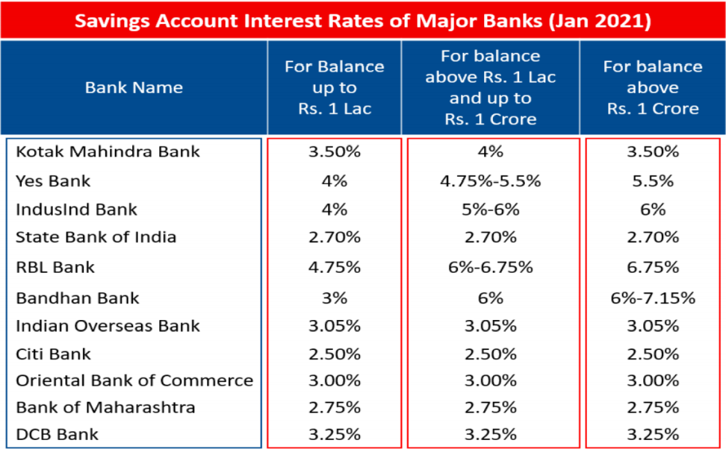
Interest Rate
Bank Provides interest, which is slightly higher than the inflection rate.
Varying in different banks.
Rate is usually around 3-4%
Current Account
Savings Account
Fixed Deposit

Slide 19
Features
Fixed Deposit
Accounts Category
Other benefits
Investment instrument.
Safe way to grow our savings
Amount has been locked for specific interest rate.
Unaffected by changes in interest rate and market fluctuations.
Interest earned is taxable.
Minor can open account.
Special concession schemes and benefits in banks by govt. for people living below poverty line..
Higher interest rate to senior citizens.
Some banks offers accident cover or life insurance with accident cover.
Locker facility.
For senior citizens and physically disabled people banks provides Door-Step banking.

Slide 20
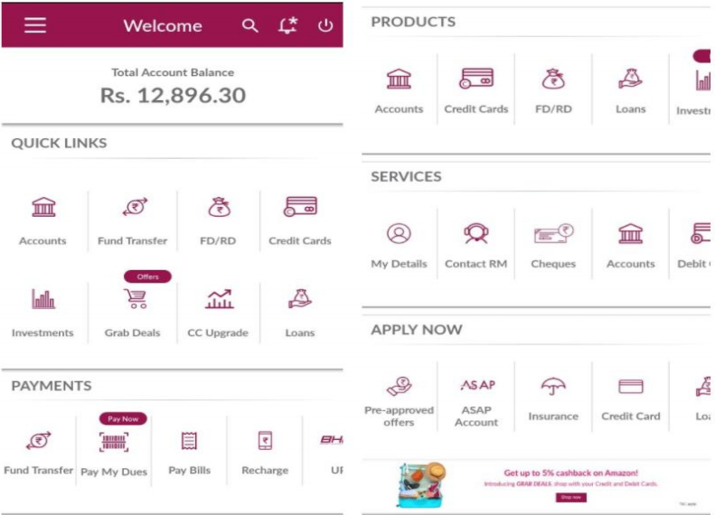
Internet Banking Facility
Most of banks provides.
We have to do KYC.
Services : Account Balance / Transactions / UPI / NEFT / Create FDs / Credit bills
Current Account
Savings Account
Fixed Deposit

Slide 21
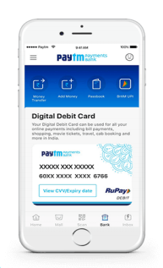
Digital Savings Account
Paytm Payment Bank and Kotak 811 which provides totally online savings account.
Offers savings account with ZERO opening charges or minimum balance required.
Keep upto 1 Lac deposit.
Free virtual debit card or can order physical at lowest charges.

Slide 22
Recurring Deposit Account

Slide 23
What is Recurring Deposit ?
Generally there are two types of Term Deposits, Recurring and Fixed Deposit.
Recurring Deposit - Deposit money at regular intervals and earn interest on deposits made
Best investment option for people who cannot deposit lump sum at one time, low salaried people and pensioners.
Invest money time to time

Slide 24
Features

Slide 25
Features and Benefits
Money
Deposit Features
Other benefits
Nothing to lose while investing money.
Safe way to grow our savings and make a habit of saving money.
TDS is applicable on Recurring Deposits. If interest earned exceeds 40000 p.a. , 10% is deducted by respective banks.
Interest is compounded on quarterly basis on Recurring Deposits.Minimum Deposit Amount varies from bank to bank
Interests earned are higher than that of Savings and Current Account, equivalent to that of Fixed Deposit.
Interest Earned depends on tenure of deposit.
The interest rates offered to senior citizens for their deposits are usually 1-2% higher than that offered to general public.
At the end of the deposit tenure, the depositor receives a lump cash along with accumulated interest which can be reinvested if the depositor is willing to do so.

Slide 26
Limitations

Slide 27
Limitations
When you deposit the money in an RD, you will never have the privilege to withdraw any part of the money until the term of the deposit is over.
Hence, if you are looking for an easy liquidity instrument, recurring deposits are an absolute bad idea.
On the other hand, if you want to discipline your savings this disadvantage may work to your benefit.
It is not possible in the case of recurring deposits to be able to change your deposit amount, regardless of your financial situation at the moment.
With a fixed amount for investment each month, someone with chances of extra or less funds for the deposit should be discouraged from opting for this product.

Slide 28
Interest Rates Offered by different Banks
Bank | Interest Rates ( % ) ( General Public ) | Interest Rates ( % ) ( Senior Citizen )
State Bank of India | 6 | 6.5
ICICI Bank | 6.2-6.4 | 6.7-6.9
Axis Bank | 6.4-6.5 | 7.05-7.15
HDFC Bank | 6.3 | 6.8
Kotak Mahindra Bank | 6-6.2 | 6.5-6.7
Deutsche Bank | 5.5-7.75 | 5.5-7.5

Slide 29


Slide 30
Fixed Deposit Account
Investment scheme provided by banks and non-banking financing companies
Offer greater return than regular saving account
Short-term or long term investment period
Withdraw of money is not possible before maturity without financial repercussions
early withdrawal is possible after the payment of penalties

Slide 31
Types
Standard Fixed Deposit
Tax-saving Fixed Deposit
Corporate Fixed Deposit
Senior Fixed Deposit
Flexi Fixed Deposit
Cumulative Fixed Deposit
Non-cumulative Fixed Deposit
NRO Fixed Deposit
NRE Fixed Deposit

Slide 32
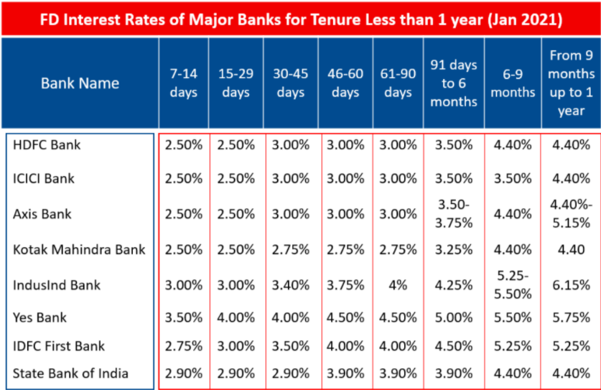
Interest Rate
Bank Provides interest, which is higher than the saving accounts.
Varying in different banks as per period of FD.
Period may range from 7 days to 10 years
Current Account
Savings Account
Fixed Deposit

Slide 33
Benefits
Guaranteed Return
Higher Interest rates
Limited Tax Benefits
Provide assured returns on your investment as the banks are governed by RBI
Investments are relatively risk-free when compared to other forms of investments
Investors receive a fixed rate of interest on the amount invested.
Offer a comparatively higher rate of interest rate than other forms of traditional investments such as savings accounts and recurring deposits.
Investors can opt for tax saver fixed deposits to avail tax benefits up to Rs. 1.5 lakh, as prescribed under Section 80C of the Income Tax Act 1961
Most FDs providing tax saver benefits have a lock-in period between 3 to 5 years

Slide 34
Limitations
Deposit Lock-in
Early Withdrawal
Limited Tax Benefits
A lump sum amount is locked-in for a specific period
Cannot use this money in case of emergencies in order to ensure proper returns from the investment
Decides to initiate a premature withdrawal from an FD lead to penalties and additional charges
Investor will not eligible for tax benefits on the fixed deposit interest earning unless investor opts for tax-saving FD

